Slide 1
Engineering Hub Proposal
Modern Intranet for the Engineering Department
Transforming Collaboration and Productivity
Presented by: Haaron Gonzalez
Date: Feb 12, 2025

Slide 2
Why the Engineering Hub?
Challenge: Current tools and file shares are outdated and limit productivity.
Opportunity: By leveraging SharePoint Online and Microsoft Teams, we can:
Modernize workflows.
Enhance collaboration.
Boost productivity.
Vision: Introduce the Engineering Hub Intranet Portal to empower the team with modern tools and resources.

Slide 3
Engineering Hub Proposal
Objective: Provide a centralized platform to:
Improve access to project-related content.
Enhance management of standards and policies.
Leverage modern tools for better productivity and collaboration.
Key Benefits:
Simplified document management with metadata.
Better organization of project and standards documentation.
Streamlined collaboration and communication across teams.

Slide 4
Key Reasons to Transition
Boost Productivity Provide modern tools to enhance the daily work of the Engineering team.
Centralized Project Management:
Dedicated sites for project-related content.
Metadata and tagging for better organization and future access.
Standards and Policies Management:
Dedicated site for easier handling of standards and policies.
Unified access to all relevant documentation.

Slide 5
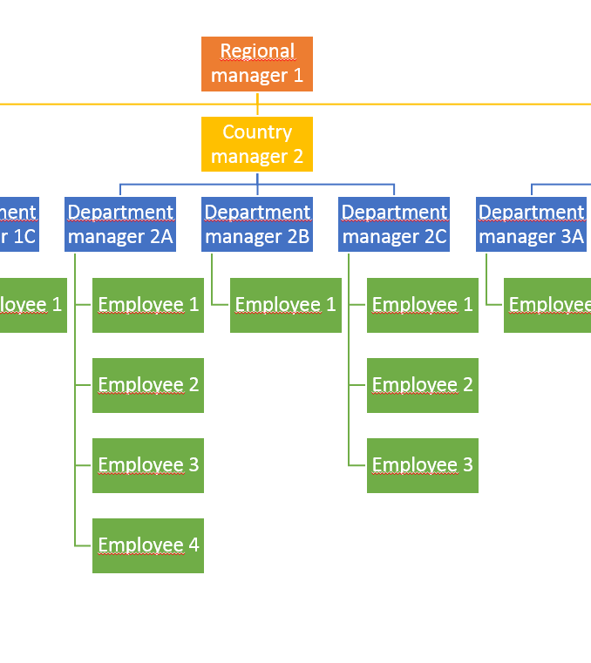
Proposed Structure
Engineering Hub (Hub Site):
Central navigation and unified access to resources.
Sub-Sites:
Standards and Policies.
Projects.
Process Documentation.
Media Library.
Tools and Resources.
Pages
Modern pages with document library web parts.
Metadata
Tags for better organization and searchability.
Security
Role-based permissions to ensure proper access control.
https://ruizfoods.sharepoint.com/sites/test-hr-hub

Slide 6
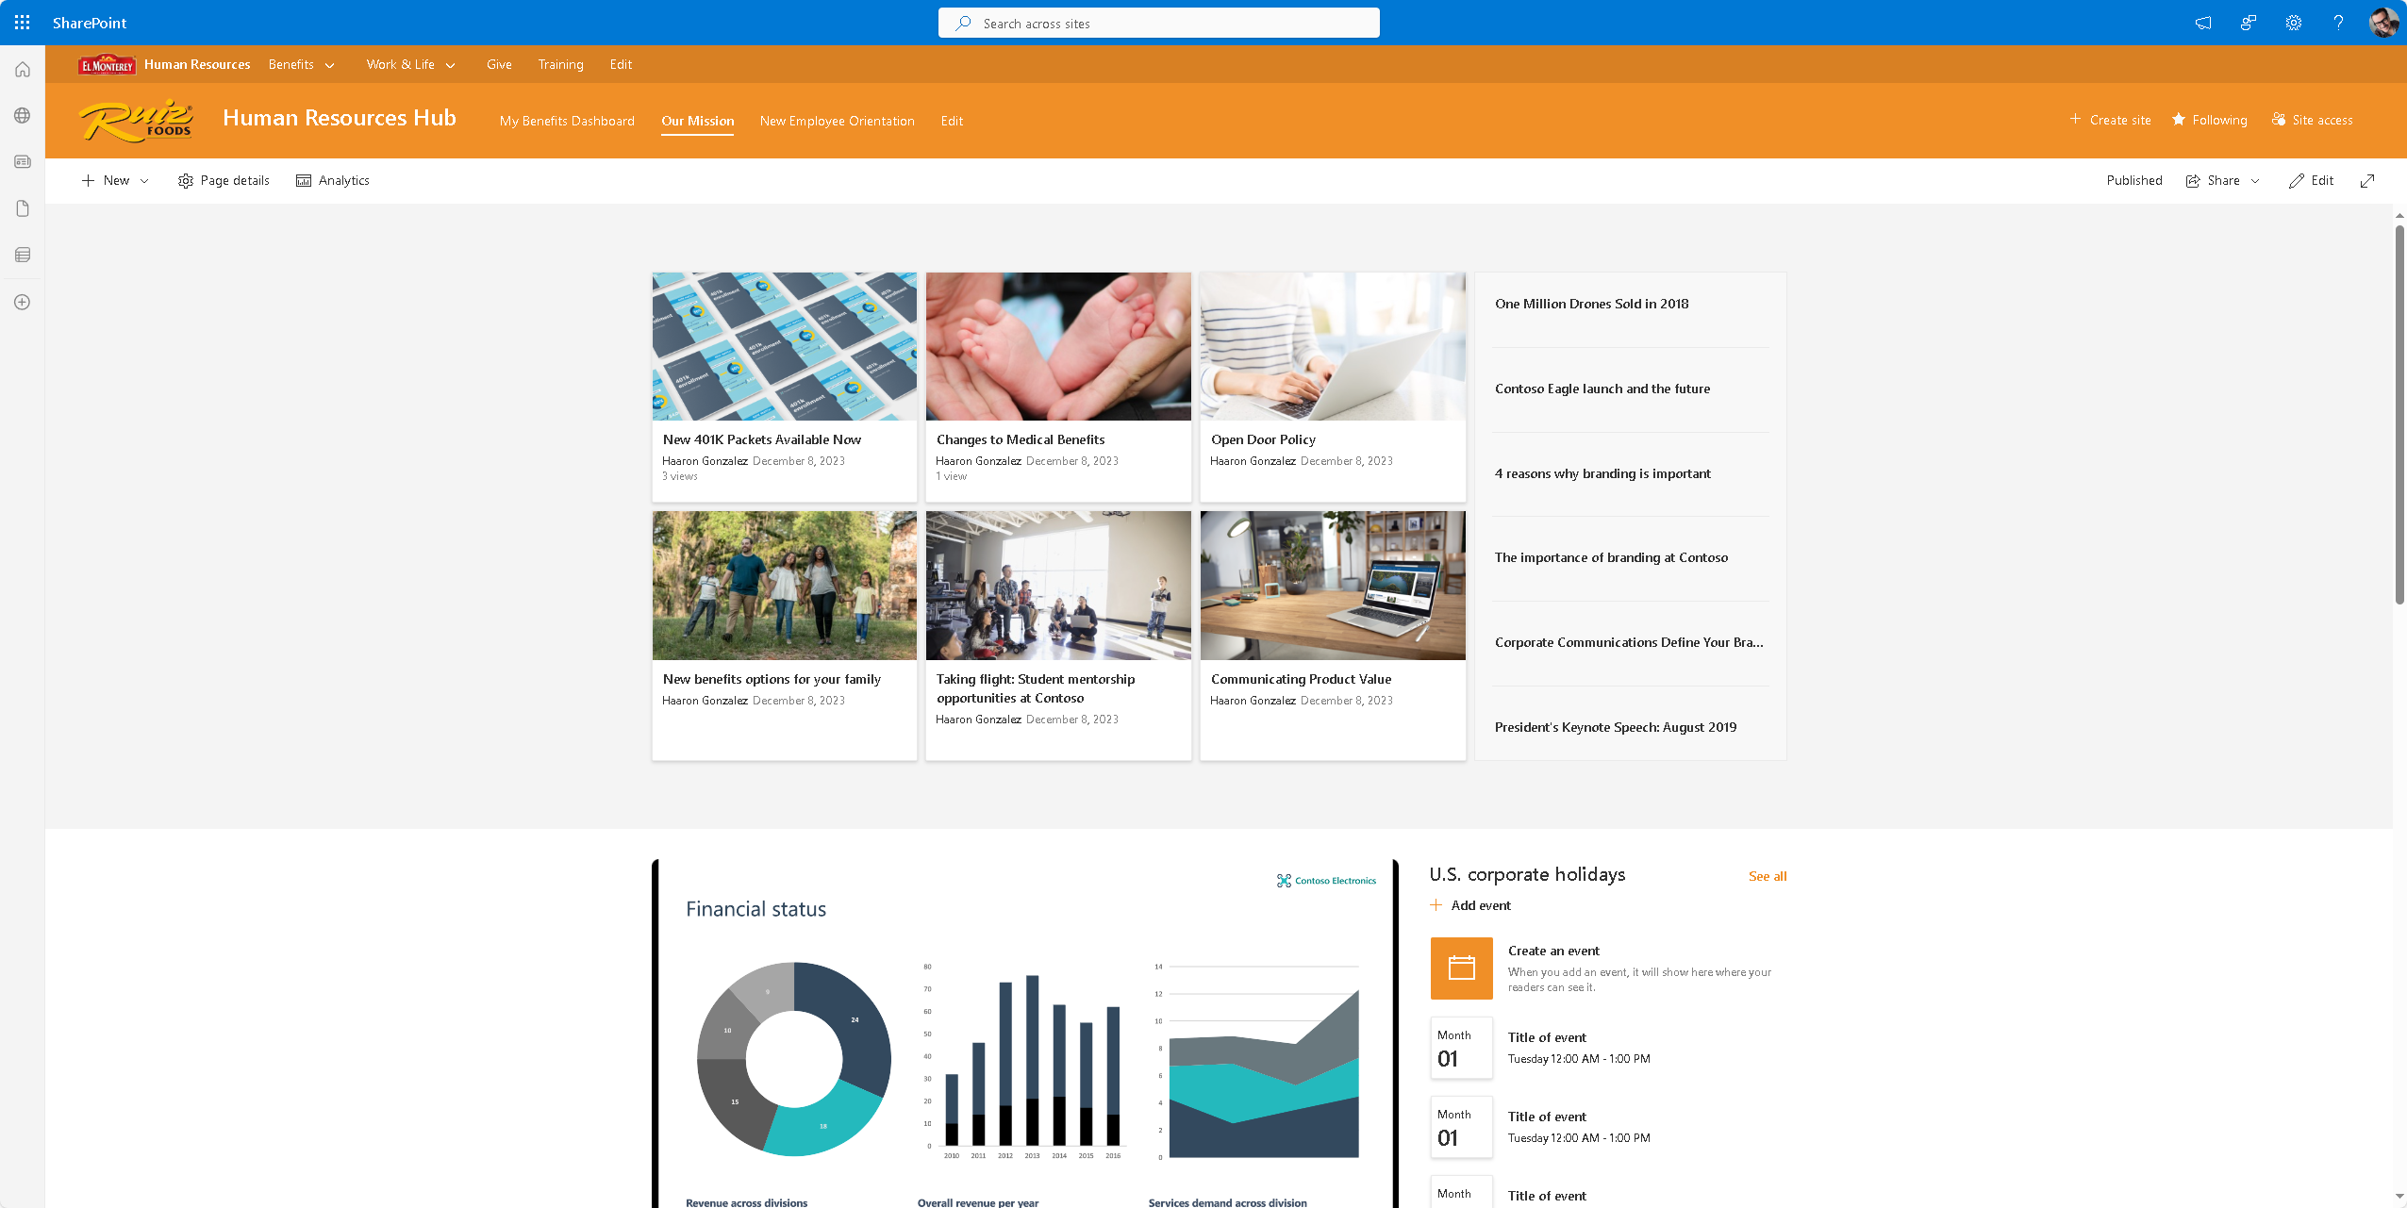

Slide 7
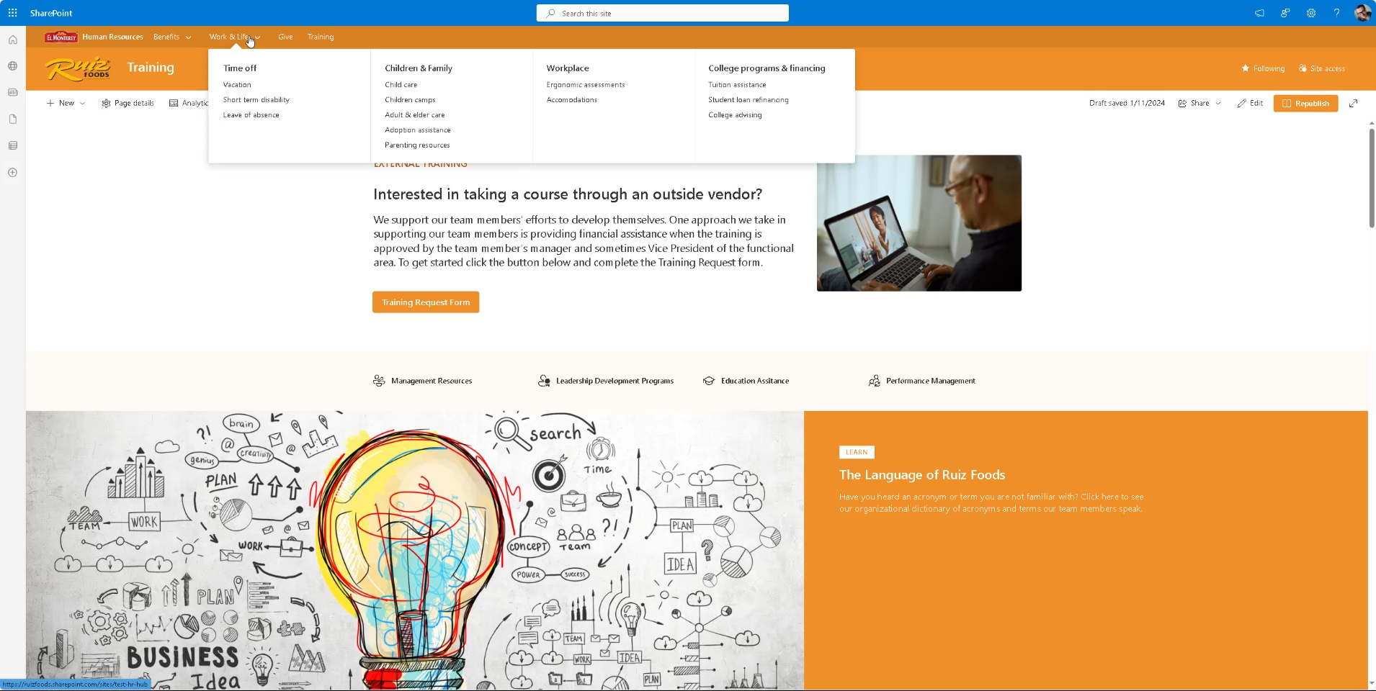

Slide 8
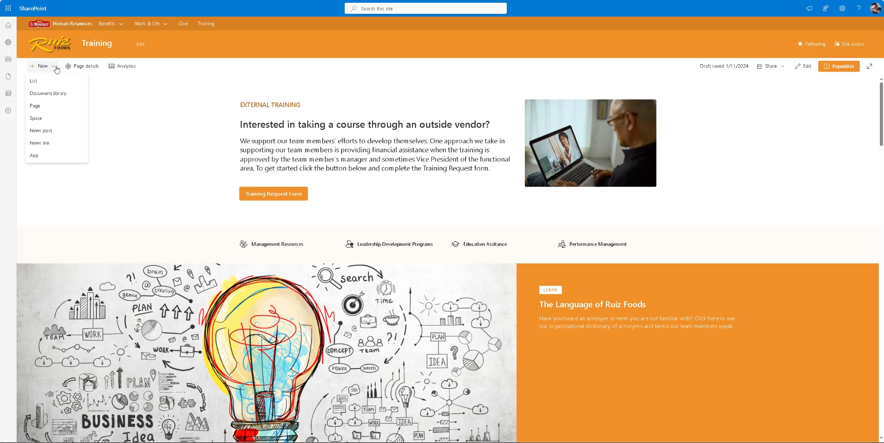

Slide 9
Project Management Made Easy
Current State: Disorganized folders make it hard to find and manage project content.
Proposed Solution:
Dedicated site for all project-related content.
Document libraries categorized by project phase and status.
Metadata fields: Project Name, Status, Location (plant), Manager.
Benefits:
Easier access to current and archived project information.
Better tracking and retrieval of project data.

Slide 10
Managing Standards and Policies
Current State: Standards and policies scattered across folders.
Proposed Solution:
Dedicated site for CAD standards, policies, and guidelines.
Document libraries for CAD Blocks, Symbols, and Policies.
Modern pages for standards overview and updates.
- Benefits:
Consistent and centralized documentation.
Simplified updates and version control.

Slide 11
Example Engineering Hub Structure
Engineering Hub (Hub Site):
Standards and Policies
Projects
Process Documentation
Media Library
Tools and Resources

Slide 12
Standards and Policies
Engineering Hub (Hub Site):
Standards and Policies
Projects
Process Documentation
Media Library
Tools and Resources
Purpose: Replace "00 - Ruiz Dwg Standards."
Modern Site:
Document Libraries:
Engineering Standards (CAD Standards, Sanitary Design Modules, etc.)
Vendor Policies (Preferred Vendor Policy)
Metadata:
Document Type, Last Updated, Owner.
Security:
Restricted to Engineering managers and senior team members for edits.
Pages:
CAD Standards Page (with web parts linking to CAD Blocks, Symbols, etc.)
Policies Page (with web parts linking to policies and standards).

Slide 13
Projects
Purpose: Replace "40 - CEP Projects," "55 - R&D Projects," "100 - Special Projects."
Modern Site:
Document Libraries:
Active Projects (sub-categorized by Project Name or Phase)
Archived Projects
Metadata:
Project Name, Status (Active/Completed), Location, Manager.
Security:
Restrict access by project team.
Pages:
Project Dashboard Page: Rollup of ongoing projects using Power BI integration.
Individual Project Pages: Dedicated pages for major projects with timelines, documents, and updates.
Engineering Hub (Hub Site):
Standards and Policies
Projects
Process Documentation
Media Library
Tools and Resources

Slide 14
Process Documentation
Purpose: Replace "60 - Process Flow Diagrams."
Modern Site:
Document Libraries:
Flow Diagrams (categorized by process type)
Templates (Reusable process flow templates)
Metadata:
Process Type, Revision Date, Owner.
Security:
Open for all Engineering team members, restricted edits.
Pages:
Process Overview Page: Descriptions of key processes with web parts linking to diagrams.
Instrumentation Page: Focused on P&IDs and technical specifications.
Engineering Hub (Hub Site):
Standards and Policies
Projects
Process Documentation
Media Library
Tools and Resources

Slide 15
Media Library
Purpose: Replace "70 - Pictures" and "75 - Video."
Modern Site:
Document Libraries:
Image Library (categorized by site and purpose)
Video Library (training and testing videos)
Metadata:
Media Type, Site, Date.
Security:
View access for all; restricted edits for media admins.
Pages:
Site Photos Page: Galleries for each site (e.g., Dinuba, Florence).
Training Videos Page: Embedded videos with descriptions.
Engineering Hub (Hub Site):
Standards and Policies
Projects
Process Documentation
Media Library
Tools and Resources

Slide 16
Tools and Resources
Purpose: Replace "20 - Templates," "35 - Master Plans," "25 - Letters of Conformity."
Modern Site:
Document Libraries:
Templates Library (categorized by document type: forms, plans, etc.)
Plans Library
Metadata:
Document Type, Date, Owner.
Security:
Editable by Engineering leadership.
Pages:
Templates Page: Links to frequently used forms and templates.
Tools Page: Links to integrated tools (e.g., AutoCAD, Power Automate workflows).
Engineering Hub (Hub Site):
Standards and Policies
Projects
Process Documentation
Media Library
Tools and Resources

Slide 17
Leveraging Modern Tools
SharePoint Online:
Metadata tagging for better search.
Version control and automated approvals.
Microsoft Teams Integration:
Real-time collaboration on projects.
Channels for discussions and document sharing.
Power Automate Workflows:
Automate document approvals and notifications.
Streamline equipment transfer requests.

Slide 18
Moving from File Shares to SharePoint
Steps:
Content Audit: Identify active, archived, and redundant files.
Mapping: Translate file share folders to SharePoint libraries.
Metadata Application: Tag files during migration.
Training: Educate the team on new tools and workflows.
Tools: ShareGate for migration, PowerShell for metadata assignment.

Slide 19
Gaining Team Buy-In
Proposed Steps:
Present the Engineering Hub concept to stakeholders.
Collect feedback and refine the proposal.
Dedicate resources to detailed planning and implementation.
Call to Action: Let’s work together to modernize and empower the Engineering department!

Slide 20
Questions?
Contact Information:
Haaron Gonzalez
haarongconsult@ruizfoods.com
Let’s build a more productive and collaborative future for Engineering!

